Slide 1
AG News Text Classification
Aimer PAM

Slide 2
AG News Text Classification
Unit 1. Problem framing and pipeline
1.1. Motivation and the 2025 NLP toolkit
1.2. Objectives O1–O8 and success metrics
1.3. Dataset, EDA and nine-phase pipeline
Unit 2. Modeling: from baselines to a tri-lingual lineup
2.1. Classical baselines and transformer scale ablation
2.2. Variance reduction: R-Drop + 3-seed ensemble
2.3. Multilingual extension (Vietnamese + French) and few-shot SetFit
Unit 3. Evaluation, deployment and outcomes
3.1. Calibration and explainability (SHAP / LIME)
3.2. Latency–accuracy Pareto front and live demo
3.3. Conclusions, outcomes and future work

Slide 3

Why AG News, and why go beyond a single BERT score
1.1
Motivation and the 2025 NLP toolkit
UNIT
01
The problem
Topic classification of short news articles into 4 classes — World, Sports, Business, Sci/Tech (Zhang, Zhao & LeCun [1]).
A single fine-tuned BERT already scores ~94 %; the open question is everything around accuracy.
The gap this project fills
One repository exercising the full modern stack — robustness, calibration, explainability, data efficiency, latency, multilinguality.
Reproducible, auditable, and deployment-aware, not a notebook.

Slide 4
Eight objectives, eight measurable targets
1.2
Objectives O1–O8 and success metrics
UNIT
01
Outcome — 6 of 8 objectives met
O1 English F1 ≥ 0.95 → 0.9528 (met); O3 Vietnamese ≥ 0.90 → 0.9041 (met); O8 French ≥ 0.90 → 0.9466 (met).
O4 ECE ≤ 0.03 → 0.0285 (met); O6 public GitHub 200 OK (met); O7 SIC report submitted (met).
The two honest misses
O2/S2 SetFit @64 ≥ 0.93 → 0.8755 (not met).
O5 latency ≤ 50 ms CPU @batch 1 → 290 ms (not met, hardware-bounded — reported transparently).

Slide 5
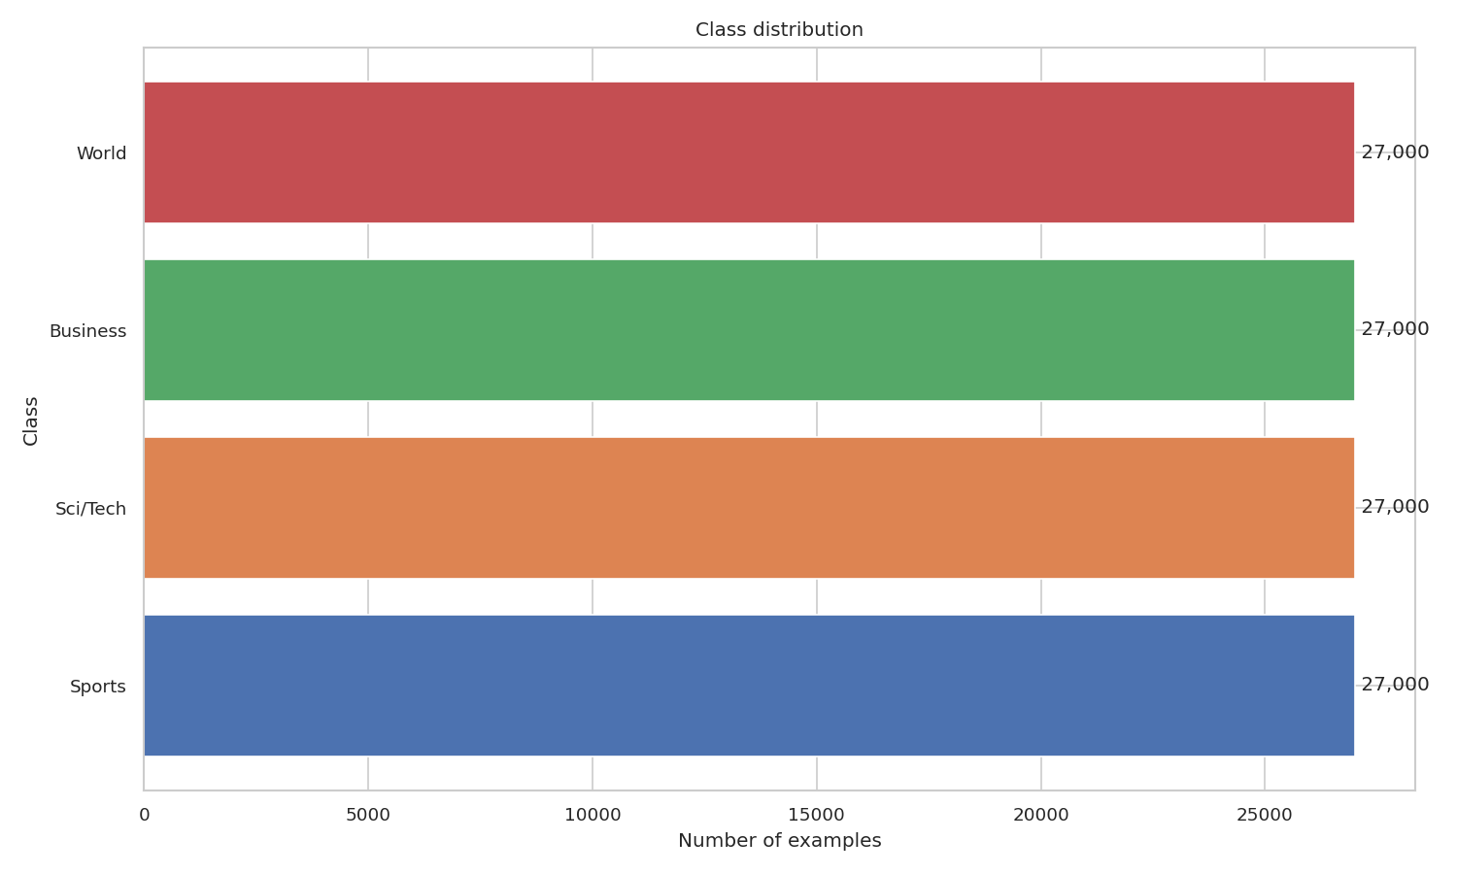
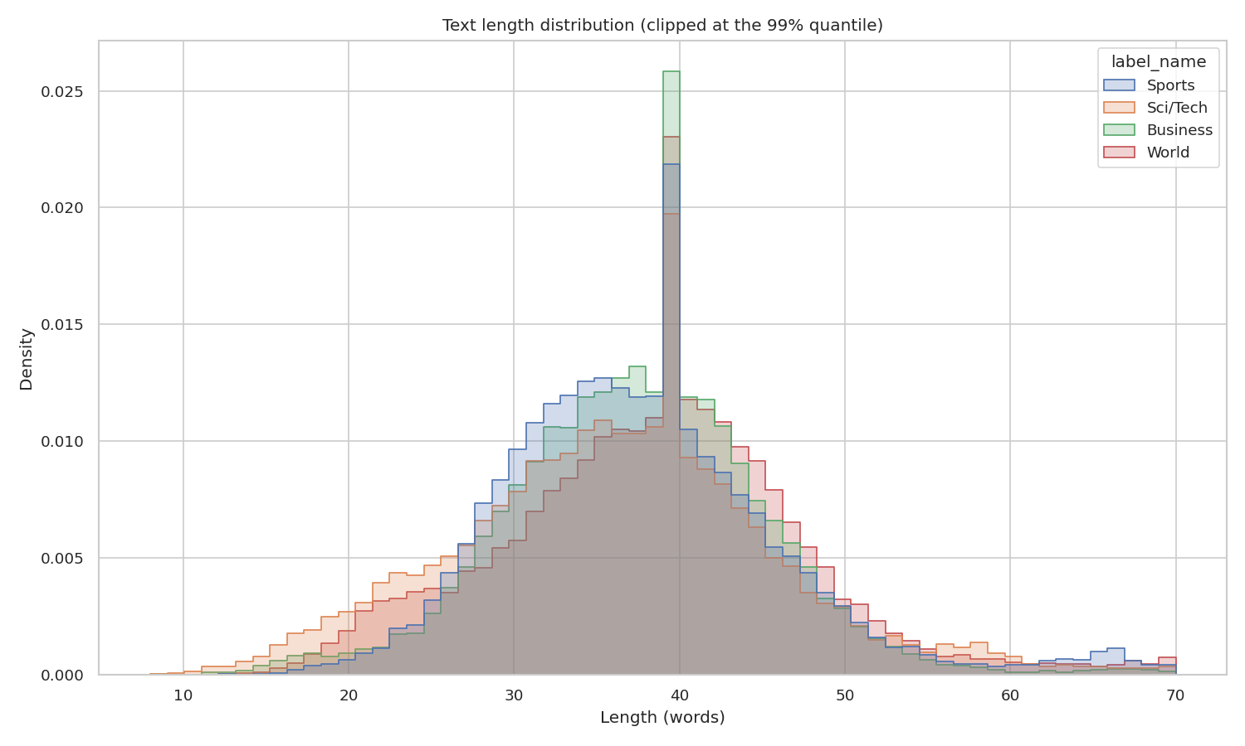
A clean dataset and a linear, reproducible plan
1.3
Dataset, EDA and nine-phase pipeline
UNIT
01
Dataset and EDA
120,000 train / 7,600 test; stratified 90/10 → 108k train / 12k val; test touched only for final reporting.
Balanced classes; Cleanlab flags 2,852 (2.6 %) likely mislabels, mostly on the Business ↔ Sci/Tech boundary; BERTopic for topic structure.
Figure: Four classes, perfectly balanced (30,000 each)
Nine-phase, 76-day pipeline
Data → baselines → transformers → multilingual → few-shot → evaluation → deployment → report; each phase = one runnable scripts/phase{N}.py.
Every output under outputs/, every input under configs/ — no implicit state.
Figure: Median 38 words; 99th percentile ≈ 80 → max_len 256

Slide 6
Establishing the reference point, then scaling up
2.1
Classical baselines and transformer scale ablation
UNIT
02
Classical baselines (the sanity check, F1-macro)
TF-IDF + Linear SVM 92.54 %, TF-IDF + LogReg 91.64 %, FastText 91.70 % (~2.5 min total, CPU).
Transformer scale ablation (English, F1-macro)
DeBERTa-v3-small 94.63 % (44 M) → ModernBERT-base 94.71 % (149 M) → DeBERTa-v3-base 94.93 % (184 M) → ModernBERT-large 94.98 % (395 M).
Strong encoders beat the best classical baseline by 2.44 pp — but a single checkpoint still sits 0.02 pp below the 0.95 target.

Slide 7
Closing the last 0.3 pp to meet O1
2.2
Variance reduction: R-Drop + 3-seed ensemble
UNIT
02
The method
2×3 ablation grid: {vanilla, +R-Drop} × seeds {13, 42, 73} on ModernBERT-large.
R-Drop adds symmetric KL between two stochastic forward passes (Liang et al. [9]); checkpoints combined by soft-voting (Dietterich [10]).
The method
R-Drop 3-seed ensemble = 0.9528 F1-macro — meets O1 by +0.28 pp over target.
Honesty caveat: N=3 seeds → the F-test / paired t-test for variance and mean gains are underpowered (Section 3.3.2.5).

Slide 8
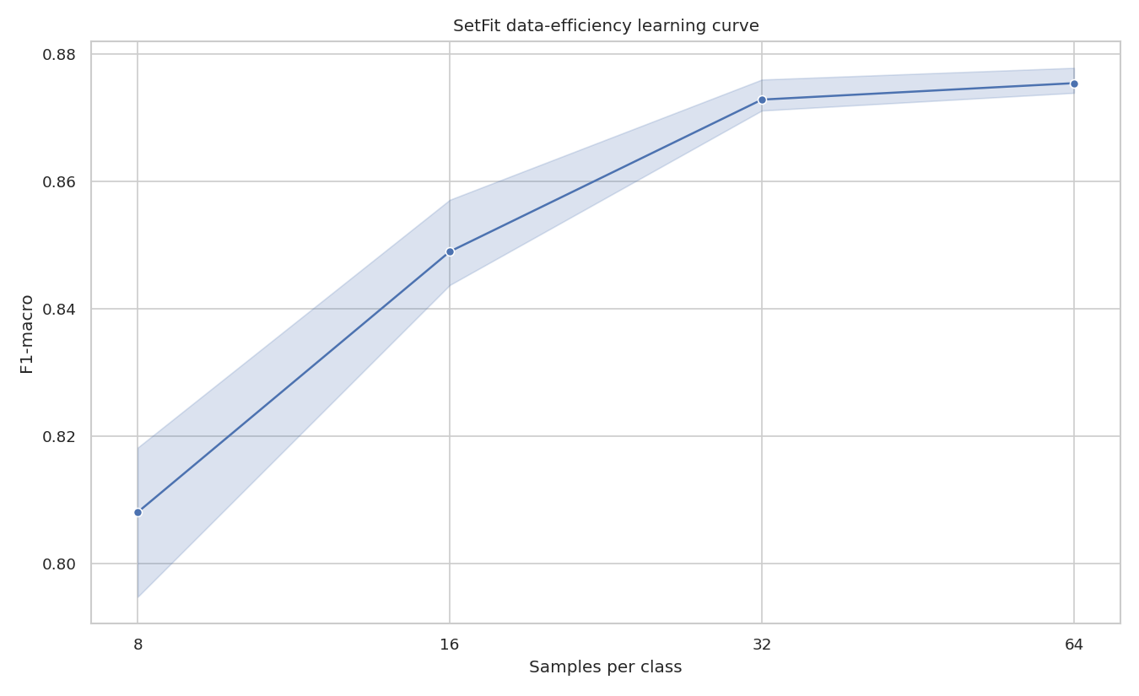
Three languages and a data-efficiency curve
2.3
Multilingual extension and few-shot SetFit
UNIT
02
Vietnamese + French (OPUS-MT + back-translation)
2×2 grid/language (mDeBERTa-v3 184 M vs XLM-R-large 550 M × back-translation); VI best XLM-R-large + BT 0.9041 (O3); FR best XLM-R-large 0.9466 (O8); scale > augmentation in low-resource.
Corpora are 100 % machine-translated — quality unmeasured (BLEU/chrF/COMET scope-out), an honest bound on the result.
Few-shot SetFit (data efficiency)
K = 8/16/32/64 per class; @64 reaches 0.8755 — recovers 92.2 % of supervised F1 with 0.24 % of the labels.
Misses the 0.93 target (S2) but tells a strong label-efficiency story.
Figure: SetFit recovers 92.2 % of supervised F1 with 0.24 % of the labels

Slide 9
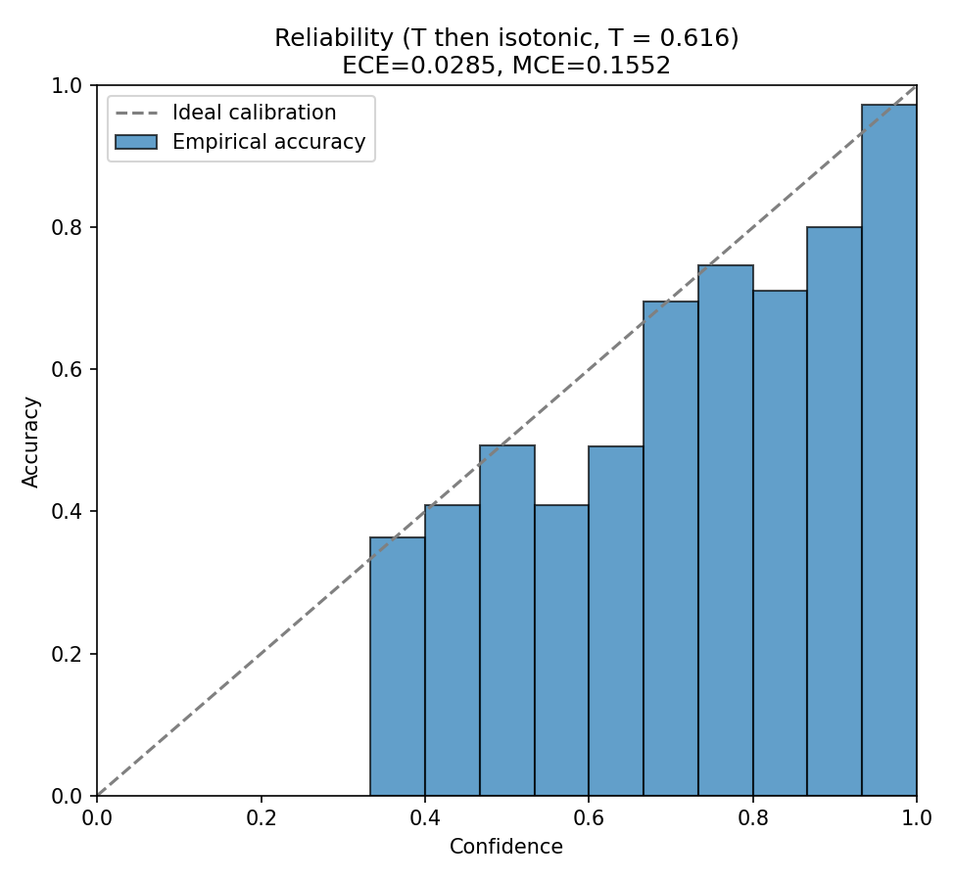
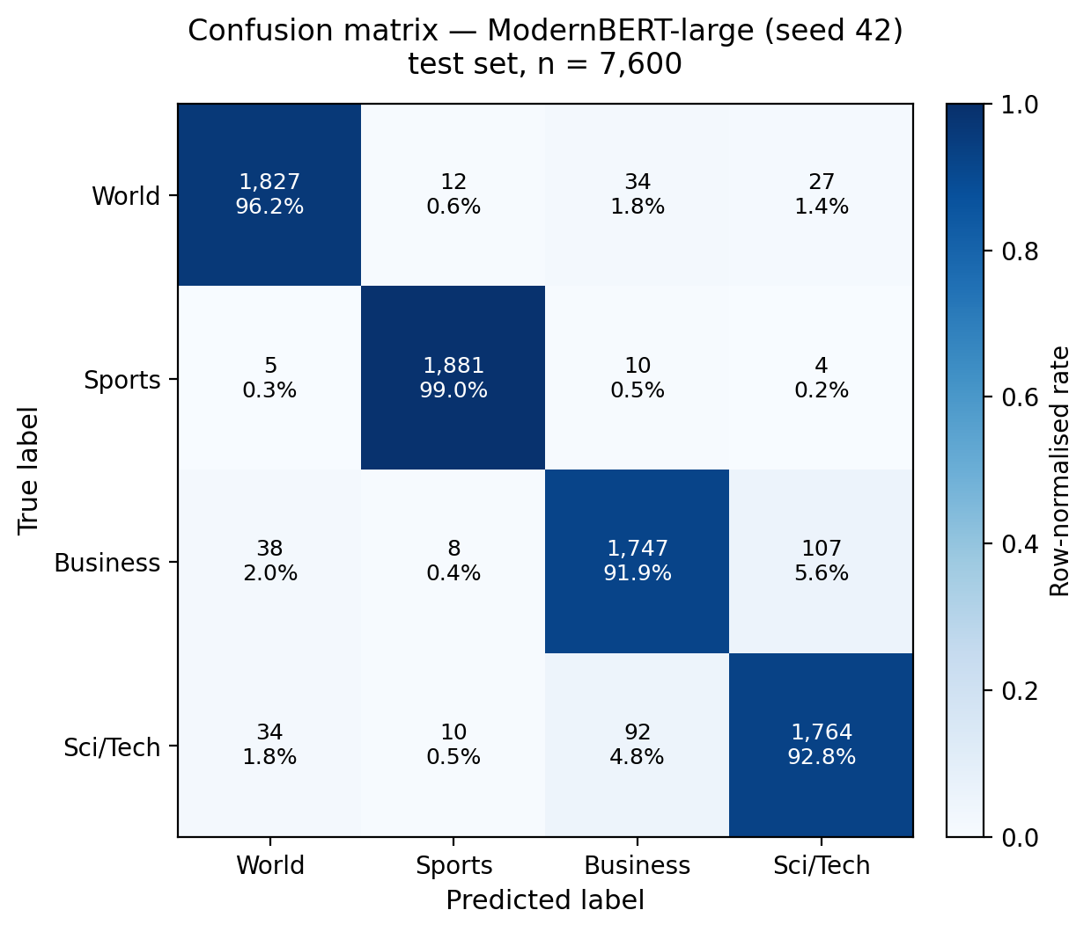
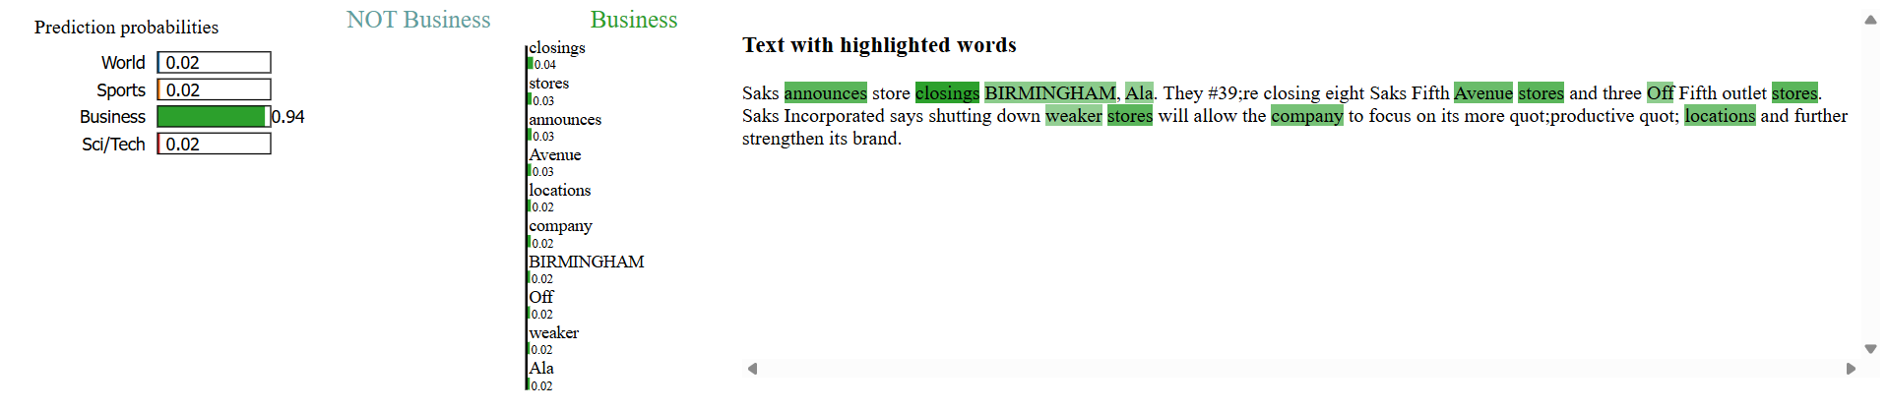
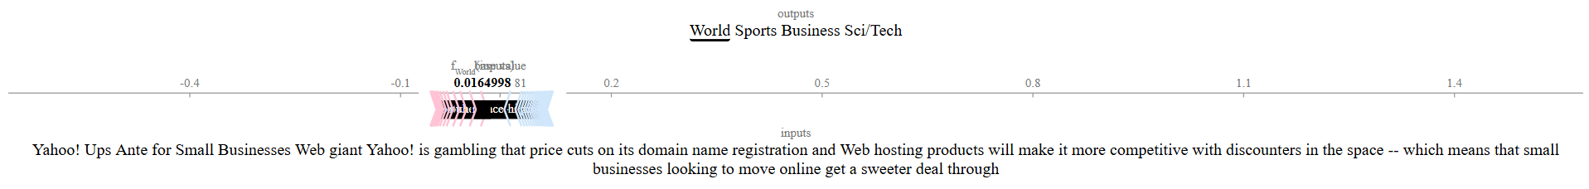
Trustworthy probabilities and transparent decisions
3.1
Calibration and explainability
UNIT
03
Calibration (meets O4)
4-calibrator grid: baseline / temperature / class-wise isotonic / chained T→isotonic.
Chained T→isotonic drops ECE 0.0502 → 0.0285
(≤ 0.03); SE caveat per Roelofs [36], Vaicenavicius [37].
Figure: Chained T→isotonic calibration drops ECE from 0.0502 to 0.0285 (≤ 0.03)
Figure: Business ↔ Sci/Tech accounts for 52.4 % of the 380 test errors
Explainability + error analysis
SHAP TextExplainer [18] + LIME [19] run on the deployed model and surfaced in the UI — not buried in an appendix.
Business ↔ Sci/Tech accounts for 52.4 % of the 380 test errors — the dominant, interpretable failure mode.
Figure: SHAP — finance tokens push a Sci/Tech article toward Business
Figure: LIME on the same article — both methods blame the same tokens

Slide 10
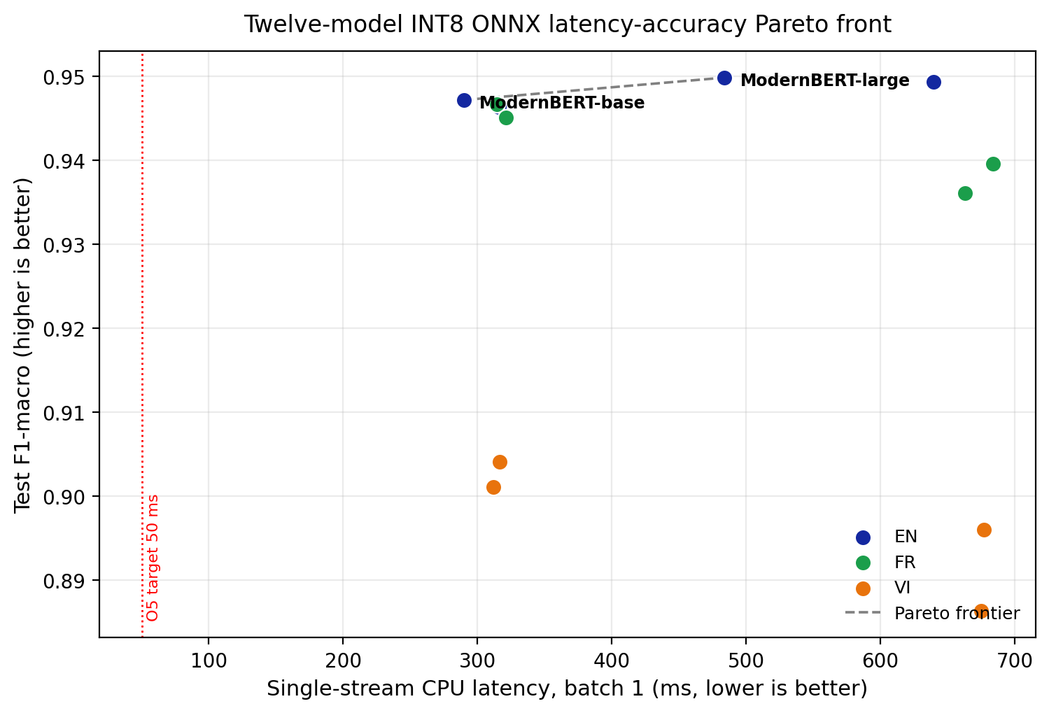
Twelve models, one Pareto front, one live app
3.2
Latency–accuracy Pareto front and live demo
UNIT
03
Deployment engineering
All 12 encoders → ONNX opset 17 → dynamic INT8 via Optimum; full 12-row latency–accuracy Pareto front on one host.
Pareto-optimal single checkpoint: ModernBERT-base INT8 (147 MB, 94.71 % F1, 289.83 ms/sample, single-stream CPU).
Live Gradio demo (embedded video)
One dropdown over all 12 checkpoints; automatic EN/VI/FR routing; sliding-window long-document path; SHAP highlighting.
O5 latency miss is hardware-bounded (no INT8 model clears 50 ms @batch 1 on commodity x86) — reported, not hidden.
Figure: ModernBERT-base INT8 is Pareto-optimal (147 MB, 289.83 ms, F1 0.9471)

Slide 11
What was delivered, and what comes next
3.3
Conclusions, outcomes and future work
UNIT
03
Conclusions
Performance — R-Drop ensemble 0.9528 (O1); tri-lingual 0.9041 VI / 0.9466 FR (O3, O8); calibrated to 0.0285 (O4).
Breadth — baselines → transformers → multilingual → few-shot → calibration → explainability → INT8 deployment, fully reproducible.
Future work
NLLB-200 / shared-encoder multi-task to lift VI & FR; instruction-tuned LLM zero-shot baseline (O2); static-calibration INT8 (O5); continuous-evaluation CI dashboard.

Slide 12
Thank you — Questions?
Q&A / Selected references
Aimer PAM · Vo Hai Dung
github.com/VoHaiDung/ag-news-text-classification
Selected references
[1] Zhang, Zhao & LeCun (2015) — Character-level ConvNets / AG News
[6] Warner et al. (2024) — ModernBERT
[9] Liang et al. (2021) — R-Drop
[10] Dietterich (2000) — Ensemble methods
[12] Tunstall et al. (2022) — SetFit
[14] Tiedemann & Thottingal (2020) — OPUS-MT
[18] Lundberg & Lee (2017) — SHAP
[19] Ribeiro et al. (2016) — LIME
[22] Guo et al. (2017) — Temperature scaling
[23] Zadrozny & Elkan (2002) — Isotonic regression
[36] Roelofs et al. (2022) — Calibration-error bias
[37] Vaicenavicius et al. (2019) — Evaluating calibration

